Slide 1
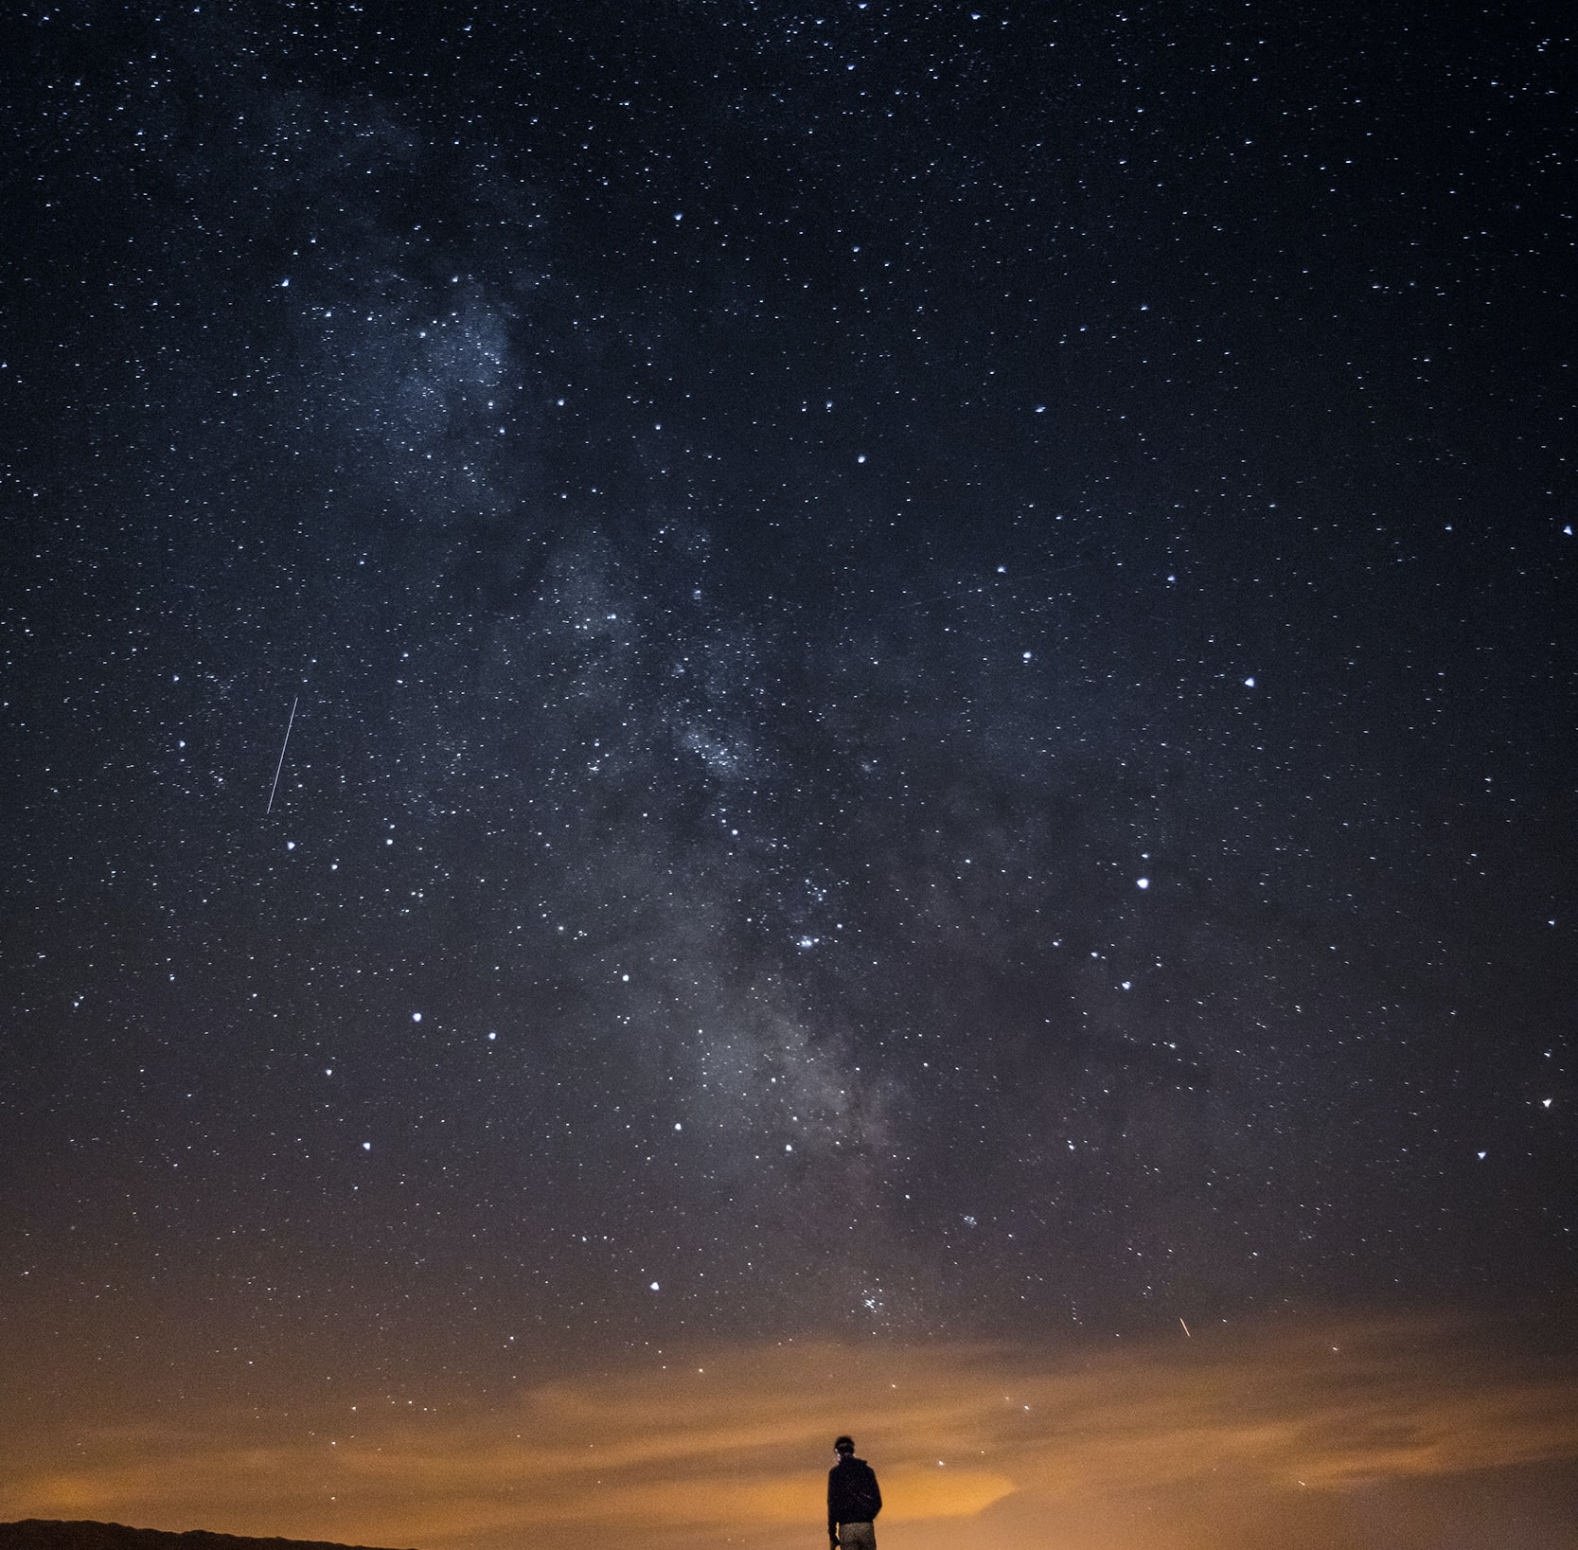
Creative Programming and Computing
Music and Acoustic Engineering
Ed uscimmo a riveder le stelle
Inferno XXXIV, 139
Gianmarco Debortoli – Federico Ceriola
a.a. 2021/2022

Slide 2
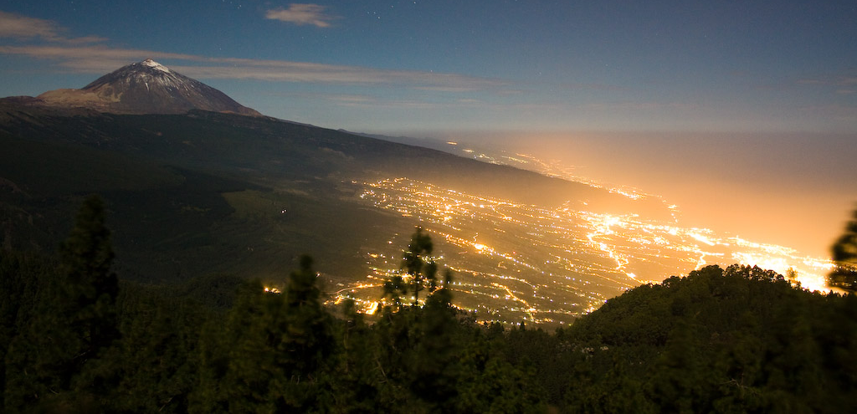
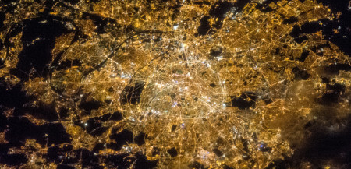
Creative Programming and Computing
Music and Acoustic Engineering
Main Concept:
Lights pollution in the dark sky:
Light Pollution unnecessarily contributes to climate change.
Light pollution kills millions of birds a year.
Artificial light at night disrupts the seasonal cycle of trees.
Relevant number of people have never seen the real sky at night (the Milky Way).
Exposure to artificial light at night puts your health at risk.
Gian Marco De Bortoli – Federico Ceriola
a.a. 2021/2022

Slide 3


Creative Programming and Computing
Music and Acoustic Engineering
Our Story:
Interactive Installation
Imagine you could switch off all the artificial lights on the planet.
You would be able to see the real natural light of the dark sky.
It would be the same experience of a child discovering the world, with the same curiosity and same astonishment.
Visual and sound discovering experience
Gian Marco De Bortoli – Federico Ceriola
a.a. 2021/2022

Slide 4
Creative Programming and Computing
Music and Acoustic Engineering
Physical tools:
Software tools:
We give a special flashlight to the «child» (user), which is used to navigate onto the skies. It is a cylindrical object with a colored face.
He/she stands in front of a camera which captures the image and his/her motion.
With the use of color tracking we aim at mapping the position of the flashlight and projecting it on the screen. We use it to «unveil» the stars from the polluted sky.
The interaction with the stars sends OSC messages to Ableton in order to produce sound.
Gian Marco De Bortoli – Federico Ceriola
a.a. 2021/2022

Slide 5
Creative Programming and Computing
Music and Acoustic Engineering
Gian Marco De Bortoli – Federico Ceriola
a.a. 2021/2022

Slide 6
Creative Programming and Computing
Music and Acoustic Engineering
Pointing Mechanism
The «torch» indicates a point on the screen (the red one) that is the center of a circle.
Every star that is in the circle interact froma sounding point of view depending on:
Distance from the center
Dimensions
Brillance
Color
Gian Marco De Bortoli – Federico Ceriola
a.a. 2021/2022

Slide 7
Creative Programming and Computing
Music and Acoustic Engineering
Gian Marco De Bortoli – Federico Ceriola
a.a. 2021/2022

Slide 8
Creative Programming and Computing
Music and Acoustic Engineering
Gian Marco De Bortoli – Federico Ceriola
a.a. 2021/2022

Slide 9
Creative Programming and Computing
Music and Acoustic Engineering
Gian Marco De Bortoli – Federico Ceriola
a.a. 2021/2022

